Slide 1
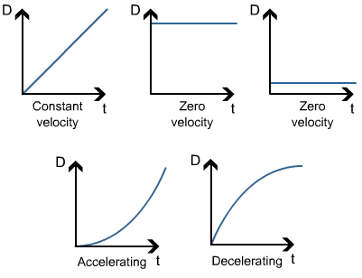
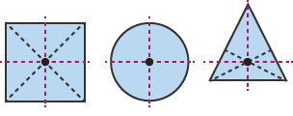
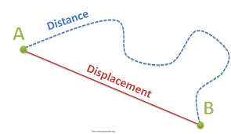
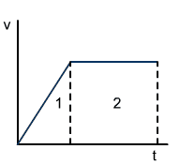
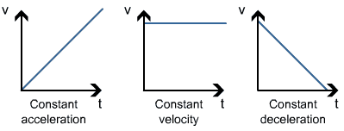
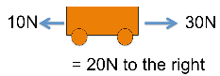
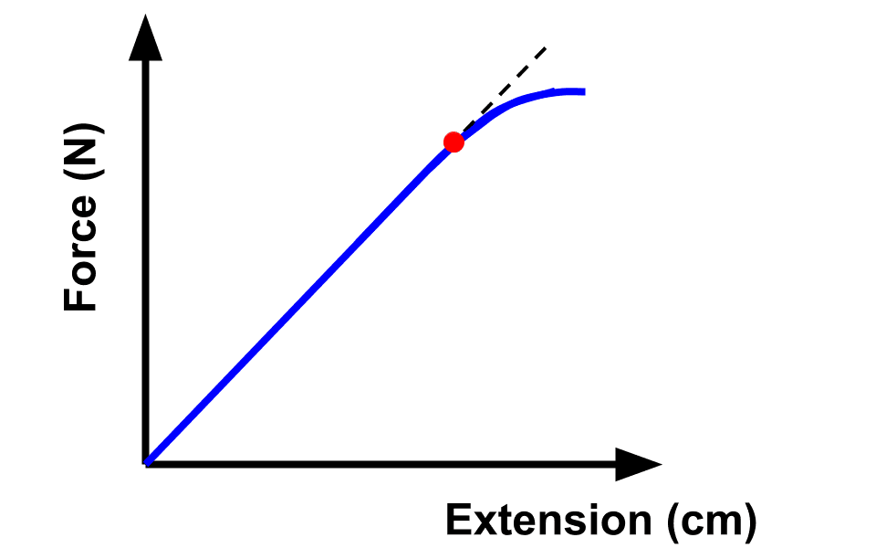
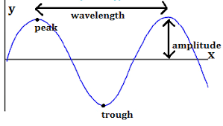
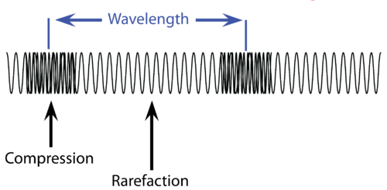
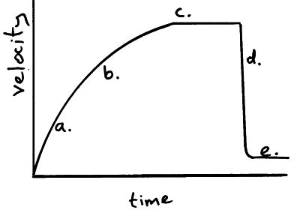
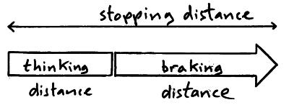
Scalar quantities- magnitude only (distance, speed, volume)
Vector quantities – magnitude AND direction (e.g. force, velocity)
Contact forces – friction, air resistance, tension
Non-contact – gravitational, electrostatic, magnetic
P2
Velocity (Vector) – speed in a given direction
A Ferris wheel may have constant speed but changing velocity
On a distance – time graph the gradient = velocity (y axis/ x axis)
A tangent could be used if the line is not linear (accelerating or decelerating)
Weight = mass x gravity Weight and Mass are directly proportional
Centre of Mass – weight acts at a single point
Displacement includes both the distance an object moves, measured in a straight line from the start point to the finish point and the direction of that straight line. Displacement is a vector quantity
Speed (scalar)
Speed = distance / time
walking ̴1.5 m/s
running ̴3 m/s
cycling ̴6 m/s
car ̴ 13-30m/s
train ̴ 50m/s
plane ̴ 250m/s
Sound in air ̴ 330m/s
Work done = force x distance 1Joule = 1 newton metre
1J of work is done if 1N causes an object to be displaced 1m
If a trolley is pushed 3m with a force of 2N = 6J of energy is transferred
Acceleration
Acceleration = velocity change/ time
Car ̴ 4 m/s²
Lorry ̴ 2m/s²
Work done = force x distance
1J of work is done if 1N causes an object to be displaced 1m
If a trolley is pushed 3m with a force of 2N = 6J of energy is transferred
Force = spring constant x extension Force and extension are directly proportional
To change a shape of an object (stretch, bend, compress) you apply more than one force
Elastic deformation – an object will return to its original shape
Inelastic deformation – Object stays in new shape
Limit of proportionality - spring is deformed
If the spring is not inelastically deformed, work done = elastic potential energy
elastic potential energy = 0.5 × spring constant × extension²
Velocity- Time graph
Gradient = acceleration
Distance travelled
(displacement)
= area under the graph (HT)
Area 1+ Area 2 = distance travelled
Newton’s First Law: If the resultant force = 0 a stationary object stays stationary and a moving object will have a constant speed
Continuing with rest or constant motion = inertia
Newton's Second Law: Acceleration is proportional to resultant force and inversely proportional to mass – so more resultant force = more acceleration, but more mass = less acceleration
Force = mass x acceleration
A measure of how difficult it is to make an object change velocity= inertial mass
Ratio of force: acceleration (mass = force/acceleration)
Newton’s Third Law: If objects interact the forces are always equal and opposite
If I push on a wall with 20N it will push back with 20N
Momentum = mass x velocity
Conservation of momentum: The total momentum before an event is equal to the momentum after an event. e.g. two snooker balls colliding
Terminal velocity – parachute example
a) If an object is falling it will initially accelerate due to gravity
- Acceleration as an object falls to Earth is 9.8 m/s²
b) As an object moves faster the greater the air resistance
c) The resultant force will become 0 as constant terminal velocity reached. Downwards force and upwards force balance
d) Parachute opened and velocity decreases
e) As forces balance again another Terminal velocity is reached
Waves
Transverse wave (EM waves):
Oscillations (vibrations) are at
right angles (perpendicular)
to the direction of energy
Longitudinal wave (sound):
Oscillations are in the same
direction as the energy
Stopping distance = thinking distance + braking distance
A driver’s reaction time can be affected by tiredness, distractions, drugs and alcohol
Reaction times range form 0.2s- 0.9s
A vehicle’s braking distance can be affected by adverse road and weather conditions (wet or icy) and poor condition brakes and tyres
When brakes are applied, work is done by friction force between brake and wheel. Kinetic energy decreases as car stops. Temperature will increase.
A high breaking force and quick deceleration
= brakes overheat and loss of control
Frequency = number of waves per second (Hz)
Period = 1/ frequency
Time taken for one wave
Wave speed =
wavelength x frequency

Slide 2
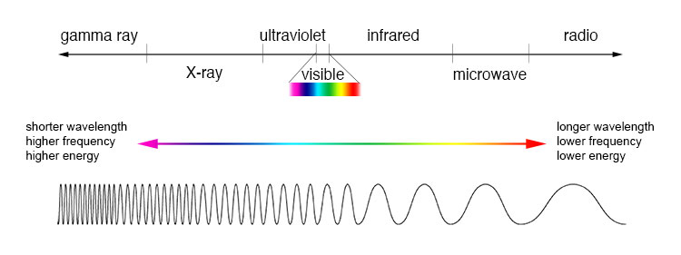
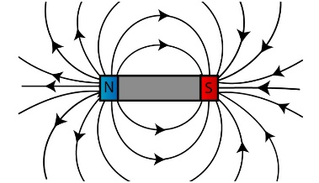
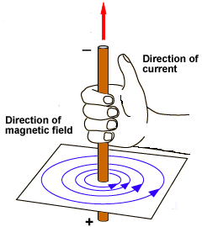
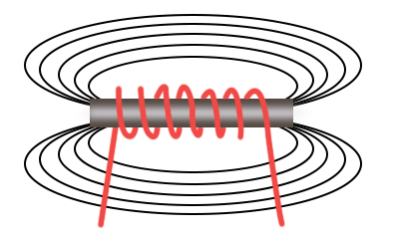
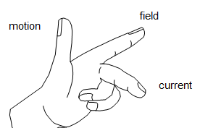
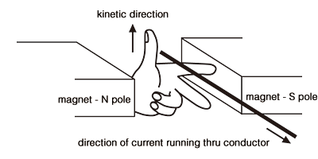
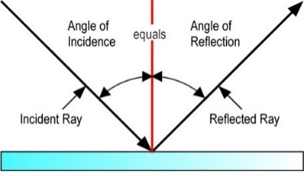
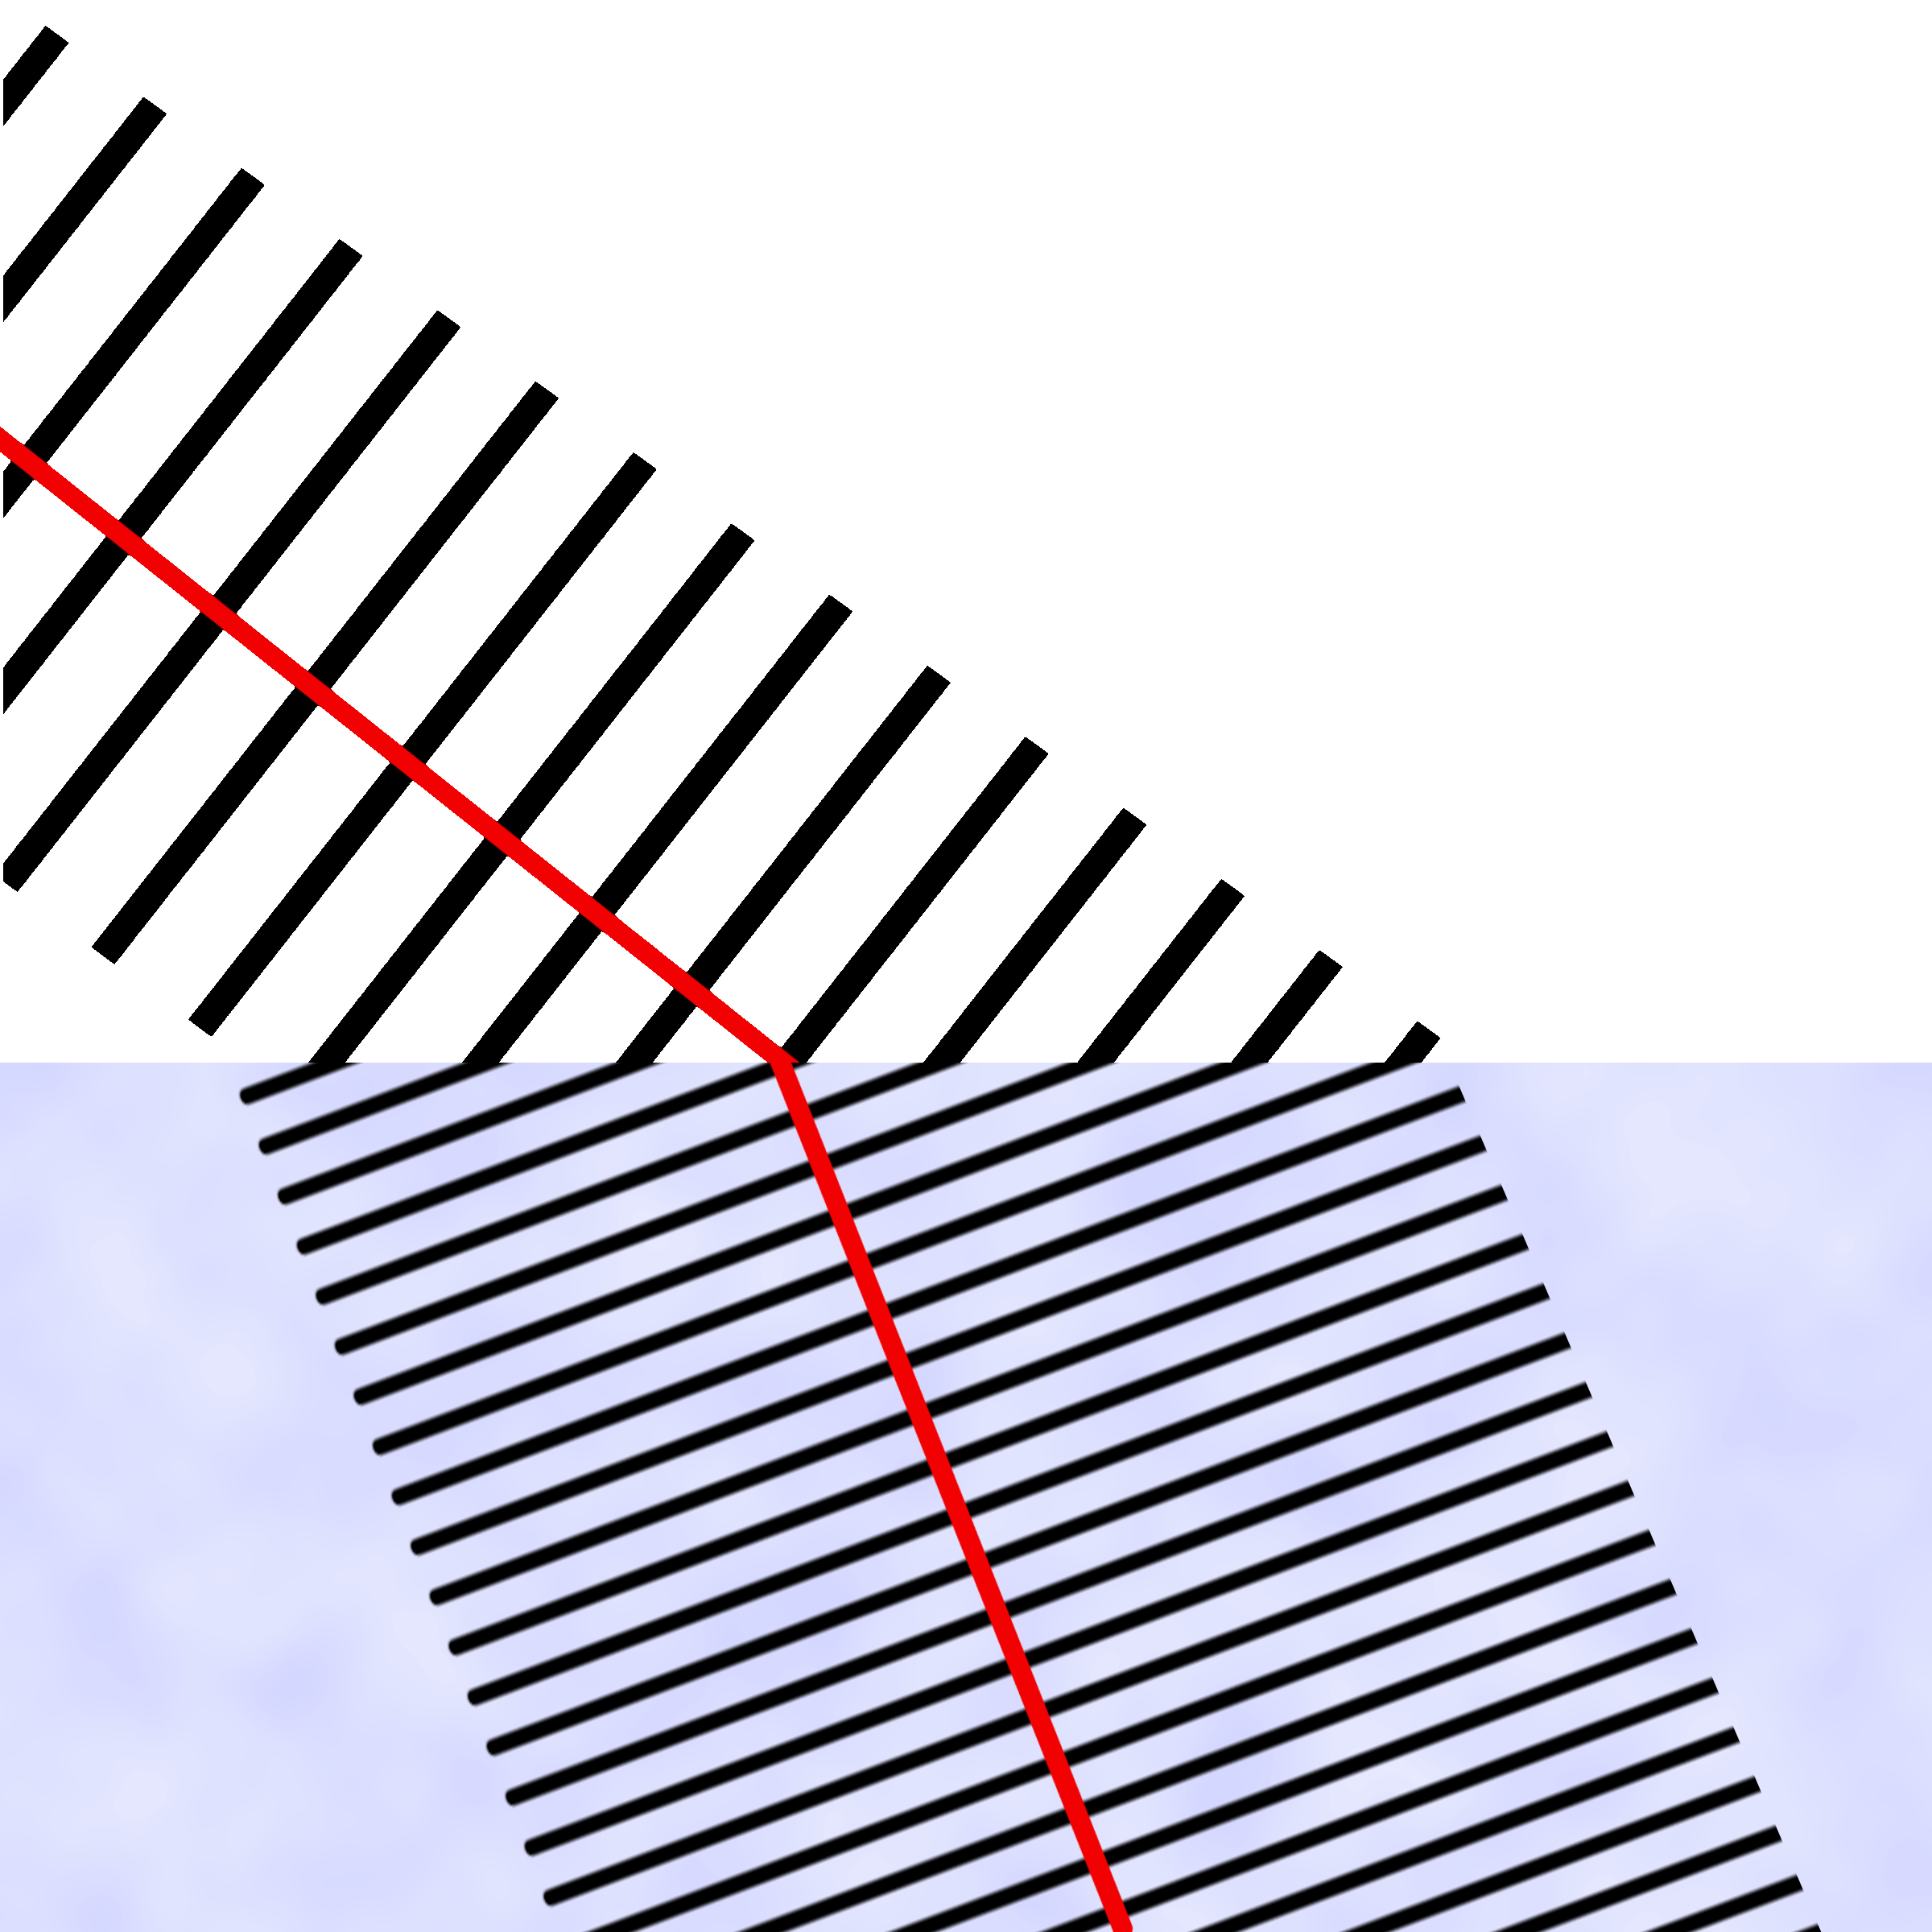
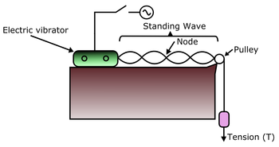
Magnetism
The poles of a magnet are the places where the magnetic forces are strongest.
Two like poles repel each other. Two unlike poles attract each other
An induced magnet is a material that becomes a magnet
only when it is placed in a magnetic field.
Magnetic metals – iron, steel, cobalt and nickel
A compass contains a small magnet. It will point in the direction of the
Earths magnetic field.
You can use a small compass to plot magnetic field lines
Radiation dose | Sv
Current | A
Force | N
Mass | kg
acceleration | m/s²
velocity | m/s
weight | N
Gravity | N/kg
Energy | J
Extension | m
Spring cons. | N/m
Work done | J
Momentum | Kgm/s
Violet
Red
Red, monkeys, in, very, unusual, x-ray, glasses
Magnetism from a conducting wire
When a current flows through a wire a magnetic field is produced
The strength of the magnetic field depends on
Current
Distance from the wire
The direction of current or magnetic field can be worked out using
the right hand grip rule
EM Spectrum: Radiowave, Microwave, Infrared, Visible light, UV, X-rays, Gamma rays (10⁻¹⁵m – 10⁴m)
All transverse waves that transfer energy from source to absorber.
All have same velocity and can travel in a vacuum (300 million m/s)
EM wave | Uses and Key points
Radio | TV and Radio telecommunication (HT)When radio waves are absorbed they create an electric alternating current with the same frequency. Information can be coded into the transmission
Microwave | Satellite communication and cooking food
Infrared | Electrical heaters, infrared cameras and cooking food Internal energy of the bonds increases when absorbed
Visible light | Fibre optic communication
ultraviolet | Energy efficient lamps and sun tanning Can cause skin aging and skin cancer
X rays | Medical imaging Ionising radiation that can mutate DNA and cause cancer
Gamma | Cancer treatment Originate from changes in an atom nucleus Ionising radiation that can mutate DNA and cause cancer
Electromagnets
If you shape a wire into a coil it is called a solenoid – this increases the magnetic field. To increase the magnetic field of a solenoid;
Increase number of coils/turns
Increase current
Use an iron core
Motor Effect
If you place a wire into a magnetic field a force will be exerted (wire moves)– this is how a motor works
The Fleming left hand rule will tell you the direction the wire will move
RP1: Elasticity: Force = spring constant x extension
IV: Weight (N) DV: Extension of the spring CV: Same spring (spring constant)
Once you have plotted force against extension you could then use this to find the weight of an unknown object by seeing how much extension there is on the spring
Safety: ensure clamp stand is secured to table
RP2a: Is Resultant Force proportional to acceleration? (Newtons 2nd Law)
IV: Hanging weight (N) DV: Calculate Acceleration using velocity change/time (using 2 light gates)
CV: Mass of trolley (Kg). Expected result: As force increases so does the acceleration
RP2b: Is acceleration inversely proportional to mass (Newtons 2nd Law)
IV: Mass of trolley (Kg) DV: Calculate Acceleration using velocity change/time CV: hanging weight (N)
Expected result: As mass increases acceleration decreases
RP3a: Ripple Tank - Wave speed = wavelength x frequency
Measure the wavelength of one wave in meters
Calculate the frequency – number of waves per second
Wave speed = wavelength x frequency
RP3b: Waves in a solid
EM Wave behaviour (HT)
Different substances may absorb, transmit, refract or reflect electromagnetic waves in ways that vary with wavelength
RP4: Leslies cube
IV: Different surfaces, DV Infrared radiation emitted CV: Distance between surface and detector
The refraction ‘wave front diagram’ shows that as a wave changes to a denser medium the wavelength gets shorter and the speed increases. If the wave hits at an angle the direction will also change
A standing wavelength is measured
Frequency is read off the signal generator
Calculate wave speed
Surface | Temperature (C)
Matt Black | 78
Shiny Black | 60
Matt White | 46
Shiny Metal | 32
Detector would have a better resolution than a thermometer

Slide 3
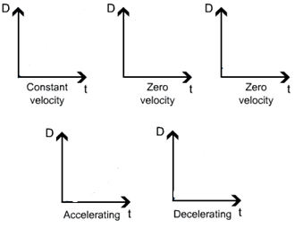
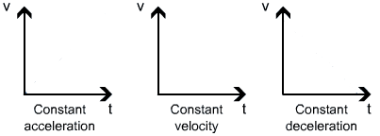
Scalar quantities- e.g
Vector quantities – e.g.
Contact forces – e.g.
Non-contact – e.g.
P2
Velocity (Vector) – is
A Ferris wheel may have constant speed but changing velocity
On a distance – time graph the gradient = velocity (y axis/ x axis)
A tangent could be used if the line is not linear (accelerating or decelerating)
Weight = mass x gravity Weight and Mass are directly proportional
Centre of Mass – weight acts at a single point
Displacement includes both the distance an object moves, measured in a straight line from the start point to the finish point and the direction of that straight line. Displacement is a vector quantity
Speed (scalar)
Speed = distance / time
walking ̴1.5 m/s
running ̴3 m/s
cycling ̴6 m/s
car ̴ 13-30m/s
train ̴ 50m/s
plane ̴ 250m/s
Sound in air ̴ 330m/s
Complete the graphs sketches
Work done = force x distance 1Joule = 1 newton metre
1J of work is done if 1N causes an object to be displaced 1m
If a trolley is pushed 3m with a force of 2N = _______ of energy is transferred
Acceleration
Acceleration = velocity change/ time
Car ̴ 4 m/s²
Lorry ̴ 2m/s²
Work done = force x distance
1J of work is done if 1N causes an object to be displaced 1m
If a trolley is pushed 3m with a force of 2N = ________ of energy is transferred
Force = spring constant x extension Force and extension are directly proportional
To change a shape of an object (stretch, bend, compress) you apply more than one force
Elastic deformation – an object will return to its original shape
Inelastic deformation – Object stays in new shape
Limit of proportionality - spring is deformed
If the spring is not inelastically deformed, work done = elastic potential energy
elastic potential energy = 0.5 × spring constant × extension²
Velocity- Time graph
Gradient = acceleration
Distance travelled
(displacement)
= area under the graph (HT)
Complete the graphs sketches
Area 1+ Area 2 = distance travelled
Newton’s First Law: If the resultant force = 0 a stationary object _______________and a moving object will have a ____________
Continuing with rest or constant motion called…
Newton's Second Law: Acceleration is proportional to resultant force and inversely proportional to mass – so more resultant force = __________ acceleration, but more mass = ______ acceleration
Force = mass x acceleration
A measure of how difficult it is to make an object change velocity= inertial mass
Ratio of force: acceleration (mass = force/acceleration)
Newton’s Third Law: If objects interact the forces are always equal and opposite
If I push on a wall with 20N it will push back with __________
Momentum = mass x velocity
Conservation of momentum is
Terminal velocity – parachute example explain the graph
a)
- Acceleration as an object falls to Earth is 9.8 m/s²
b)
c)
d)
e)
Waves
Transverse wave (EM waves):
Oscillations are
Longitudinal wave (sound):
Oscillations are
Stopping distance = thinking distance + braking distance
A driver’s reaction time can be affected by tiredness, distractions, drugs and alcohol
Reaction times range form 0.2s- 0.9s
A vehicle’s braking distance can be affected by adverse road and weather conditions (wet or icy) and poor condition brakes and tyres
When brakes are applied, work is done by friction force between brake and wheel. Kinetic energy decreases as car stops. Temperature will increase.
A high breaking force and quick deceleration
= brakes overheat and loss of control
Frequency is
Period =
Wave speed =

Slide 4
Magnetism
The poles of a magnet are the places where the magnetic forces are strongest.
Two like poles _________ each other. Two unlike poles ________ each other
An induced magnet is a material that becomes a magnet
only when it is placed in a _______________________
Magnetic metals – iron, steel, cobalt and nickel
A compass contains a small magnet. It will point in the direction of the
Earths magnetic field.
You can use a small compass to plot magnetic field lines
Measurement | Unit
Radiation dose
Current
Force
Mass
acceleration
velocity
weight
Gravity
Energy
Extension
Spring cons.
Work done
Momentum
Violet
Red
Red, monkeys, in, very, unusual, x-ray, glasses
Magnetism from a conducting wire
When a current flows through a wire a magnetic field is produced
The strength of the magnetic field depends on
The direction of current or magnetic field can be worked out using
the right hand grip rule
EM Spectrum: Radiowave, Microwave, Infrared, Visible light, UV, X-rays, Gamma rays (10⁻¹⁵m – 10⁴m)
All transverse waves that transfer energy from source to absorber.
All have same velocity and can travel in a vacuum (300 million m/s)
EM wave | Uses and Key points
Radio
Microwave
Infrared
Visible light
ultraviolet
X rays
Gamma
Electromagnets
If you shape a wire into a coil it is called a solenoid – this increases the magnetic field. To increase the magnetic field of a solenoid;
Motor Effect
If you place a wire into a magnetic field a force will be exerted (wire moves)– this is how a motor works
The Fleming left hand rule will tell you the direction the wire will move
RP1: Elasticity: Force = spring constant x extension
IV: Weight (N) DV: Extension of the spring CV: Same spring (spring constant)
Once you have plotted force against extension you could then use this to find the weight of an unknown object by seeing how much extension there is on the spring
Safety: ensure clamp stand is secured to table
RP2a: Is Resultant Force proportional to acceleration? (Newtons 2nd Law)
IV: Hanging weight (N) DV: Calculate Acceleration using velocity change/time (using 2 light gates)
CV: Mass of trolley (Kg). Expected result: As force increases so does the acceleration
RP2b: Is acceleration inversely proportional to mass (Newtons 2nd Law)
IV: Mass of trolley (Kg) DV: Calculate Acceleration using velocity change/time CV: hanging weight (N)
Expected result: As mass increases acceleration decreases
RP3a: Ripple Tank - Wave speed = wavelength x frequency
Measure the wavelength of one wave in meters
Calculate the frequency – number of waves per second
Wave speed = wavelength x frequency
RP3b: Waves in a solid
EM Wave behaviour (HT)
Different substances may absorb, transmit, refract or reflect electromagnetic waves in ways that vary with wavelength
RP4: Leslies cube
IV: Different surfaces, DV Infrared radiation emitted CV: Distance between surface and detector
The refraction ‘wave front diagram’ shows that as a wave changes to a denser medium the wavelength gets _________ and the speed _________. If the wave hits at an angle the direction will also change
A standing wavelength is measured
Frequency is read off the signal generator
Calculate wave speed
Surface | Temperature (C)
Matt Black | 78
Shiny Black | 60
Matt White | 46
Shiny Metal | 32
Detector would have a better resolution than a thermometer

