Slide 1
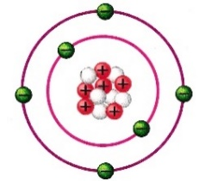
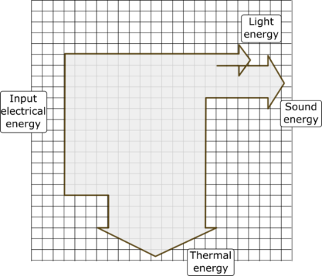
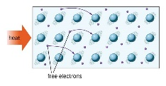
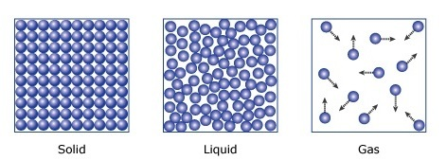
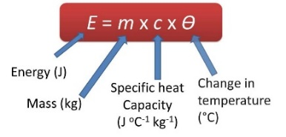
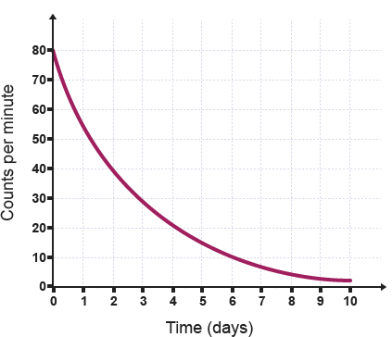
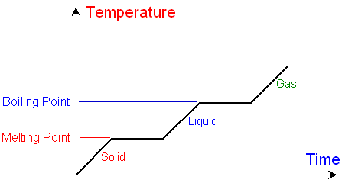


Energy can be transferred, stored or dissipated but can not be created or destroyed
Upwards projected object : kinetic store → G.P.E store
Object hitting obstacle: kinetic store → thermal and sound store
Boiling kettle: electric energy store → thermal energy store
kinetic energy = 0.5 × mass × speed²
elastic potential energy = 0.5 × spring constant × extension²
g.p.e. = mass × gravitational fi­eld strength × height
Energy in (J) = Energy out (J)
Efficiency = useful energy or power out
Total energy or power in
Waste energy is usually heat dissipated to
the surroundings. Lubrication and thermal
insulation can reduce unwanted transfers
power = energy transferred or work done/ time
Power = energy transfer of 1 Joule per second
P1
Atom Radius = 0.1nm or 1 x 10^{-10m}
Nucleus Radius =1/10,000 or an atom radius or 1 x 10^{-14m}
Sub- atomic particle | Charge | Mass
Proton | +1 | 1
Electron | -1 | 0
Neutron | 0 | 1
Source | Advantages | Disadvantages
Fossil fuels: oil, coal, gas | Provide high amounts of energy. Reliable | Non- renewable Release CO₂ (Global warming) and SO₂ (Acid rain) - Carbon capture can be used to reduce amount of CO₂ released
Nuclear | Provide very high amounts of energy No CO₂ or SO₂ released | Non- renewable Nuclear waste dangers High set up costs Difficult to decommission
Biofuel: Wood, ethanol | Renewable Carbon neutral No SO₂ released | Damage to habitats Time and space needed to grow plants
Wind and Solar | Renewable, No CO₂ or SO₂ released Low running cost | Unreliable, Visual and Noise pollution, High set up costs Low amounts of energy
Hydro- Electric, Wave power, tidal | Renewable, reliable, No CO₂ or SO₂ released Low running cost Pumped storage can be used (Hydro) | Visual and Noise pollution High set up costs Low amounts of energy Damage to habitats
Geothermal | Renewable, reliable, No CO₂ or SO₂ released Low running cost | Only possible in volcanic areas High set up costs
Absorb EM radiation = electrons move to a higher shell
Emit EM radiation = electrons move to a lower shell
Mass number = protons + neutrons
Atomic number = protons (same as electrons)
Isotopes = different versions of an element with the same protons but different neutrons
Positive ions lose electrons, negative ions gain electrons
Atom theory
“tiny spheres” → electrons discovered → plum pudding model → alpha particle scattering experiments → nuclear model (Bohr)→ proton discovered → Neutron discovered (Chadwick)
Conduction – only in solids
Heat the particles → More vibrations
vibrations passed on to neighbouring particles
Higher Thermal conductivity of a material means higher rate of energy transfer by conduction e.g. buildings cool quickly if walls are thin with and high thermal conductivity
Alpha Scattering experiments
Positive particles shot through gold atoms. Most of the particles went straight through so atom not solid and mostly empty space (plum pudding wrong). Some positive particles deflected by the small positive nuclei in the centre (nuclear model correct)
Density = mass/volume
When substances change state
Mass does not change.
Melt (solid → liquid), freeze (liquid → solid), boil and evaporate (liquid → gas) condense (gas → liquid), sublimate (solid →gas)
Internal energy is the total kinetic energy and potential energy in all atoms within an object or collection of objects (system)
Specific Heat Capacity -How much energy is needed to raise 1Kg by 1ºC
As you heat a substance the temperature increase depends on the amount of energy input, mass and type of material
Latent heat: energy needed to change state
Specific latent heat of fusion – energy needed for solid → liquid
Specific latent heat of vaporisation – energy needed for liquid → gas
There is no temperature change while a change of state is happening as energy is being used to break intermolecular bonds
Type | Structure | Ionising | Range in air | Stopped by
Alpha | 2p,2n | High | 5cm | paper
Beta | e- | Mid | 1m | Thin Al
gamma | EM radiation | Low | 1km | Lead
Pressure
If a gas is kept at a constant volume but the temperature increases, the pressure will increase due to the increase in Kinetic energy and more frequent collisions
Temperature increase is directly proportional to pressure increase if volume kept the same
How much energy is needed to heat 2Kg of water (4200J/KgºC) from 10ºC to 100ºC?
2 x 4200 x 90 = 756000J
Radiation activity is measured in becquerels and detected by Geiger-Muller tube
Half life – average time it takes for number of radioactive nuclei in a sample to halve
Contamination is unwanted presence of radioactive atoms. Suitable precautions include tongs, lead shields and limited exposure
Irradiation is exposing an object to nuclear radiation but it does not become radioactive – e.g. to sterilise fruit
Alpha decay - mass number -4, atomic number -2 (more –ve)
Beta decay – atomic number +1 (more positive)

Slide 2
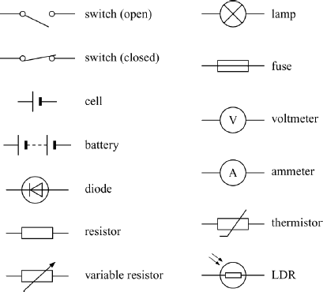
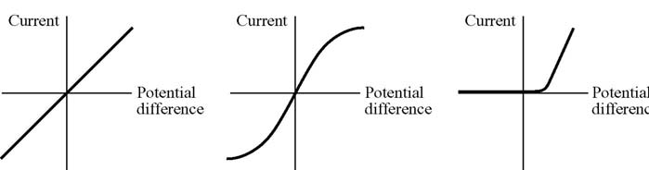
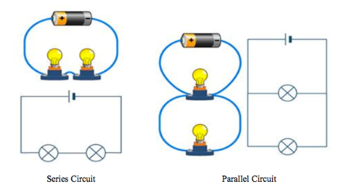
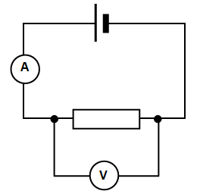
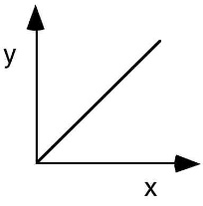
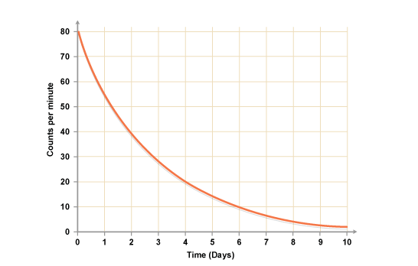
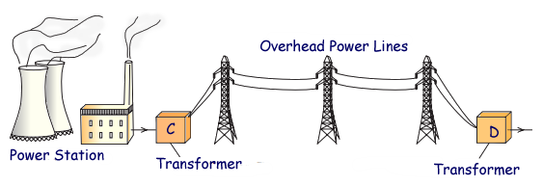

charge fl­ow = current × time PD = current x resistance
The greater the resistance the smaller the current
Current through a ohmic conductor resistor is
directly proportional to PD if temperature constant
In a filament lamp, the increase in temperature
increases kinetic energy of metal ions in the wire
and so resistance increases
In a diode the resistance is very high in one direction
LDR: Resistance decreases as light intensity increases –
e.g. in camera – light level low the shutter stays open for longer
Thermistor: Resistance decreases as temperature increases e.g. thermostat
Series circuit: add up each component resistance = total resistance
R_{total} = R1 + R2 - current is same for every component, PD is shared
Parallel circuit: PD is the same for every component ,add up each component current = total current
Adding resistors in series increases the total resistance whilst adding resistors in parallel decreases the total resistance
Bias
Organisation or companies could benefit from presenting data in a certain manner. It is better to use an “independent” company or scientist to avoid bias (they have nothing to gain)
Peer reviews make scientific results more trustworthy
RP1: Specific Heat Capacity of metal block: You need to be able to use the
equation
RP2: Resistance: Read the Q carefully to see which variable is being changed e.g. IV: Length of wire DV: Measure current and P.D and calculate Resistance (Resistance = P.D/Current) , CV: temperature of wire. As length increases, resistance increases (Plot length on x axis and Resistance on y axis)
RP3: IV Characteristics of a bulb, resistor and diode: Ensure you can explain each of the
IV graphs. We use a variable resistor to allow for a range of V (Voltage) and I (Current)
RP4: Density of regular and irregular solids and liquids : Mass = density x volume
In an irregular solid you can put the object in liquid and the displacement = volume
Household electric: DC (cells and batteries) current in one direction
AC alternates (Mains). In the UK it has a frequency of 50 cycles per second
(50 Hz) and is about 230 V
3 core cable: Blue – Neutral, Brown – live, stripes – Earth
The live wire carries the alternating potential difference from the supply (230V). The neutral wire completes the circuit. The earth wire is a safety wire to stop the appliance becoming live (0V)
If live and earth connect it is dangerous due to surge of current
Random errors could include not starting and stopping the stopwatch at exactly correct time – remove anomaly and repeat
Systematic errors is when the same error is made every time – whole experiment needs to be repeated
Zero Error – Scales have a reading even if nothing is on them. You should restart scales or data logger or take away the error for each result
Energy | J
Work done | J
Latent heat energy | J
Mass | Kg
Spring constant | N/m
Gravity | N/Kg
SHC | J/KgºC
Density | Kg/m³
Volume | m³
Radiation | Bc
Current | A
Charge | c
Time | s
Potential Diff | v
Resistance
Frequency | Hz
Power | W
Data is only reliable if it is repeated many times during experiment (repeatable) and compared with other scientists (reproducible)
Accurate data is close to true value, Precise data is close to the mean
Anomalous data does not fit the pattern or line of best fit- these should be removed when calculating a mean or repeated
Mean (average), mode (most common), median (mid value)
Categoric data is in categories – use a bar chart (colour, species)
Continuous data can be any value – use a line graph (time, temperature, length)
Power = current x PD
Power = current² × resistance
The amount of energy an appliance transfers can be calculated by;
Power = energy transfer/ time
energy transferred = charge flow × potential difference
The greater the power rating the larger the change in energy stores
e.g. High powered hair dryer will be louder and hotter
Graphs
Can have a positive, negative or no correlation
Directly proportional - both variables increase in the same ratio
(e.g. if one doubles the other also doubles)
Just saying this graph is decreasing is not good enough…
You need to say the decrease is high to start with and then becomes less
You can work out a rate by doing y/x (gradient)
National grid is a system of cables and transformers linking power stations to consumers
Step up – increase PD but lower current to reduce heat energy transferred
Step down – decrease PD to make is safe for domestic use
Economic – Who will make a profit? Environmental – Will it affect the environment or wildlife habitats?
Ethical – Is it morally right? E.g. stem cells, making nuclear weapons, testing drugs on animals

Slide 3
Energy can be transferred, stored or dissipated but can not be created or destroyed – what are they here?
Upwards projected object :
Object hitting obstacle:
Boiling kettle:
kinetic energy = 0.5 × mass × speed²
elastic potential energy = 0.5 × spring constant × extension²
g.p.e. = mass × gravitational fi­eld strength × height
Energy in (J) = Energy out (J)
Efficiency = useful energy or power out
Total energy or power in
Waste energy is usually heat dissipated to
the surroundings. Lubrication and thermal
insulation can reduce unwanted transfers
power = energy transferred or work done/ time
Power = energy transfer of 1 Joule per second
P1
Atom Radius = 0.1nm or 1 x 10^{-10m}
Nucleus Radius =1/10,000 or an atom radius or 1 x 10^{-14m}
Sub- atomic particle | Charge | Mass
Proton
Electron
Neutron
Source | Advantages | Disadvantages
Fossil fuels: oil, coal, gas
Nuclear
Biofuel: Wood, ethanol
Wind and Solar
Hydro- Electric, Wave power, tidal
Geothermal
Absorb EM radiation = electrons move to a higher shell
Emit EM radiation = electrons move to a lower shell
Mass number =
Atomic number =
Isotopes =
Positive ions ______ electrons, negative ions ______ electrons
Atom theory
“tiny spheres” → _______ discovered → plum pudding model → ______ particle scattering experiments → nuclear model (Bohr)→ ______ discovered → Neutron discovered (Chadwick)
Describe Conduction – only in solids
Alpha Scattering experiments
Density = mass/volume
When substances change state
Mass does not change.
Melt (solid → liquid), freeze (liquid → solid), boil and evaporate (liquid → gas) condense (gas → liquid), sublimate (solid →gas)
What is Internal energy
Specific Heat Capacity -How much energy is needed to raise 1Kg by 1ºC
As you heat a substance the temperature increase depends on the amount of energy input, mass and type of material
What are these?
Latent heat:
Specific latent heat of fusion –
Specific latent heat of vaporisation –
There is no temperature change while a change of state is happening as energy is being used to break intermolecular bonds
Type | Structure | Ionising | Range in air | Stopped by
Alpha | 2p,2n
Beta | e-
gamma | EM radiation
Pressure
If a gas is kept at a __________________but the temperature ___________, the pressure will increase due to the increase in Kinetic energy and more ____________________
Temperature increase is __________________________to pressure increase if volume kept the same
How much energy is needed to heat 2Kg of water (4200J/KgºC) from 10ºC to 100ºC?
2 x 4200 x 90 = 756000J
Radiation activity is measured in becquerels and detected by Geiger-Muller tube
Half life –
Contamination
Irradiation
Alpha decay - mass number -4, atomic number -2 (more –ve)
Beta decay – atomic number +1 (more positive)

Slide 4
charge fl­ow = current × time PD = current x resistance
The greater the resistance the smaller the current
Current through a ohmic conductor resistor is
directly proportional to PD if temperature constant
In a filament lamp, the increase in temperature
increases kinetic energy of metal ions in the wire
and so resistance increases
In a diode the resistance is very high in one direction
LDR: Resistance decreases as light intensity increases –
e.g. in camera – light level low the shutter stays open for longer
Thermistor: Resistance decreases as temperature increases e.g. thermostat
Series circuit: add up each component resistance = total resistance
R_{total} = R1 + R2 - current is same for every component, PD is shared
Parallel circuit: PD is the same for every component ,add up each component current = total current
Adding resistors in series _______________ the total resistance whilst adding resistors in parallel _______________ the total resistance
Bias
Organisation or companies could benefit from presenting data in a certain manner. It is better to use an “independent” company or scientist to avoid bias (they have nothing to gain)
Peer reviews make scientific results more trustworthy
RP1: Specific Heat Capacity of metal block: You need to be able to use the
equation
RP2: Resistance: Read the Q carefully to see which variable is being changed e.g. IV: Length of wire DV: Measure current and P.D and calculate Resistance (Resistance = P.D/Current) , CV: temperature of wire. As length increases, resistance increases (Plot length on x axis and Resistance on y axis)
RP3: IV Characteristics of a bulb, resistor and diode: Ensure you can explain each of the
IV graphs. We use a variable resistor to allow for a range of V (Voltage) and I (Current)
RP4: Density of regular and irregular solids and liquids : Mass = density x volume
In an irregular solid you can put the object in liquid and the displacement = volume
Household electric: DC (cells and batteries) current in one direction
AC alternates (Mains). In the UK it has a frequency of 50 cycles per second
(50 Hz) and is about 230 V
3 core cable: Blue – Neutral, Brown – live, stripes – Earth
The live wire carries the alternating potential difference from the supply (230V). The neutral wire completes the circuit. The earth wire is a safety wire to stop the appliance becoming live (0V)
If live and earth connect it is dangerous due to surge of current
Random errors is
Systematic errors is
Zero Error – Scales have a reading even if nothing is on them. You should restart scales or data logger or take away the error for each result
Measurement | Unit
Energy
Work done
Latent heat energy
Mass
Spring constant
Gravity
SHC
Density
Volume
Radiation
Current
Charge
Time
Potential Diff
Resistance
Frequency
Power
Data is only __________ if it is repeated many times during experiment (____________) and compared with other scientists (____________)
_____________ data is close to true value, _____________ data is close to the mean
__________________ data does not fit the pattern or line of best fit- these should be removed when calculating a mean or repeated
___________ (average), ____________ (most common), _____________ (mid value)
Categoric data is in categories – eg:
Continuous data can be any value – eg:
Power = current x PD
Power = current² × resistance
The amount of energy an appliance transfers can be calculated by;
Power = energy transfer/ time
energy transferred = charge flow × potential difference
The greater the power rating the larger the change in energy stores
e.g. High powered hair dryer will be louder and hotter
Graphs
Can have a positive, negative or no correlation
Directly proportional is
Just saying this graph is decreasing is not good enough…
You need to say the decrease is high to start with and then becomes less
You can work out a rate by doing y/x (gradient)
National grid is
Step up is
Step down is
Economic – Who will make a profit? Environmental – Will it affect the environment or wildlife habitats?
Ethical – Is it morally right? E.g. stem cells, making nuclear weapons, testing drugs on animals

